Slide 1
Google Play Store
By: Aditya, Alatta, Joo, Adkeme, Tanees, Kaylan
Group 2

Slide 2
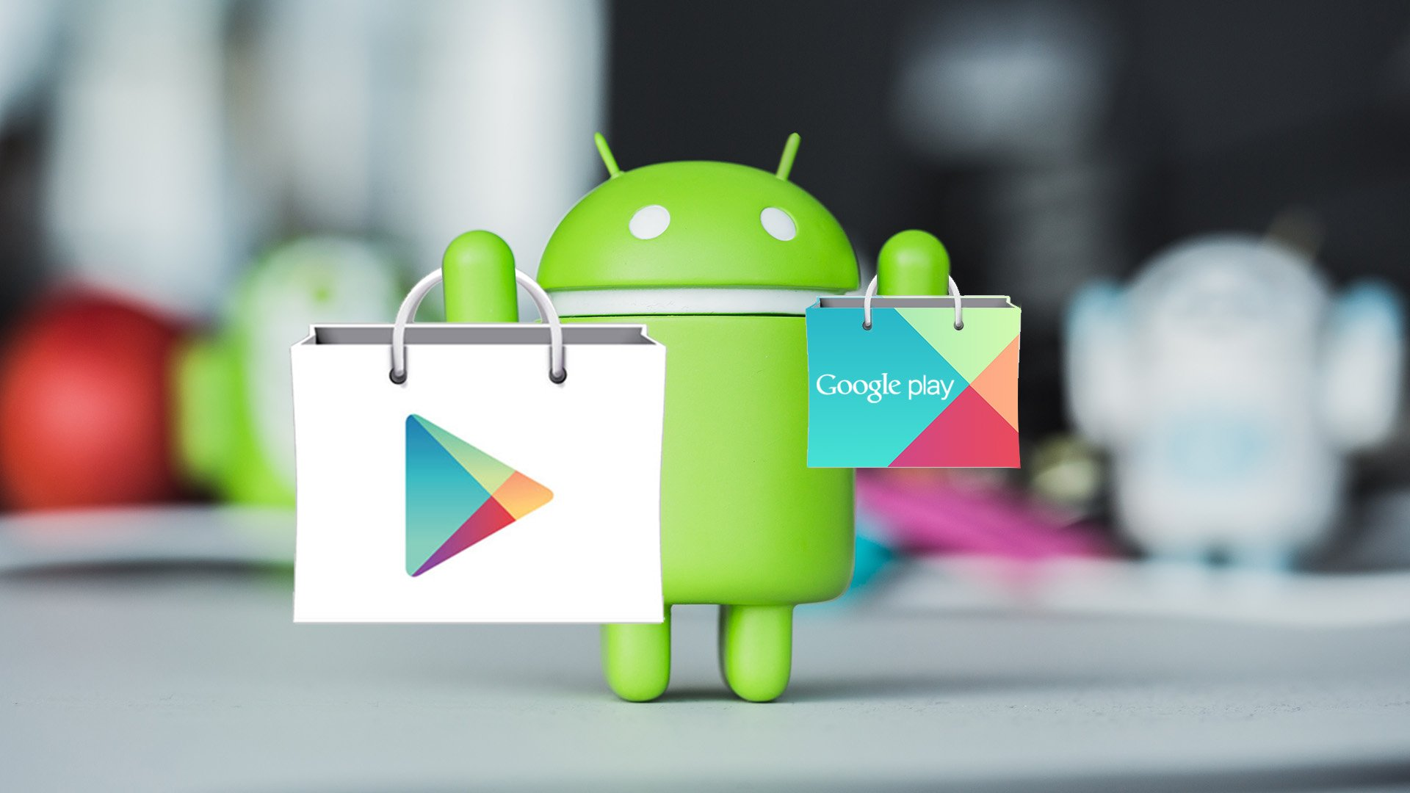
Background
Formerly known as the “Android Market” the Google Play Store is a digital distribution company owned and operated by Google.
Launched on March 6th, 2012 Google Play merged the Android Market along with Google’s movie, music and eBookstore, marking a clear shift in Google’s digital distribution strategy.
With roughly 2.5 billion people accessing the store monthly Google Play remains successful generating developers over $120 billion to date.

Slide 3

Business Problem
Ahead of 2023’s first quarter Google Play is looking for additional insights to help combat Apple’s continuous rapid growth.
Insight information regarding installs will inform Google how strongly marketing should be targeting ahead of the new year.
How does Google Play Store expand the US Android Market by increasing the number of downloads by consumers and the associated highly demanded applications.

Slide 4

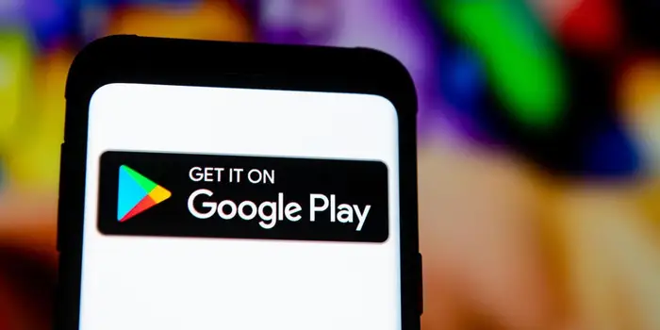
Objective
To assist Google in their marketing problem we will create an application that will offer insights into app downloads and help them find correlations between ratings, reviews and installations within the app store
We will examine the factors that increase the number of installations and which categories are more frequently installed over others to determine where the most improvements can be implemented

Slide 5
Methodology
We got our dataset from Kaggle and it is called Google Play Store Apps and contains useful variables such as Category, Ratings, Reviews, Type, Content Rating, Size, Price, and Installs
Which consists of web scraped data of 10k+ apps for analysing, and is 1.36 MB in size
This dataset was used to create our model, by comparing the number of installs to the other variables listed above

Slide 6

Preprocessing and Analysis Techniques
We first used excel to replace zero values with N/A so that the values would be considered rather than eliminated
We then used python to convert columns to strings and numerical values, and also remove special characters
Changed some strings in the numerical values, i.e for Content Rating; ‘Teen’ , ‘Everyone’ , and ‘Everyone 10+’ were given a numerical value of 1, ‘17+’ was given 2, and ‘18+’ was given 3.
The most important change we made was normalizing the ‘Installs’ ranking, giving the first ranking 33% as low success with the value 1, 33% to 66% as average success with the value 2 and anything greater than 66% as the highest success rate with the value of 3
This was necessary to restrict the number of classes for smoother use in the machine learning setting
After the model was cleaned there were 10,357 observations and 13 variables

Slide 7
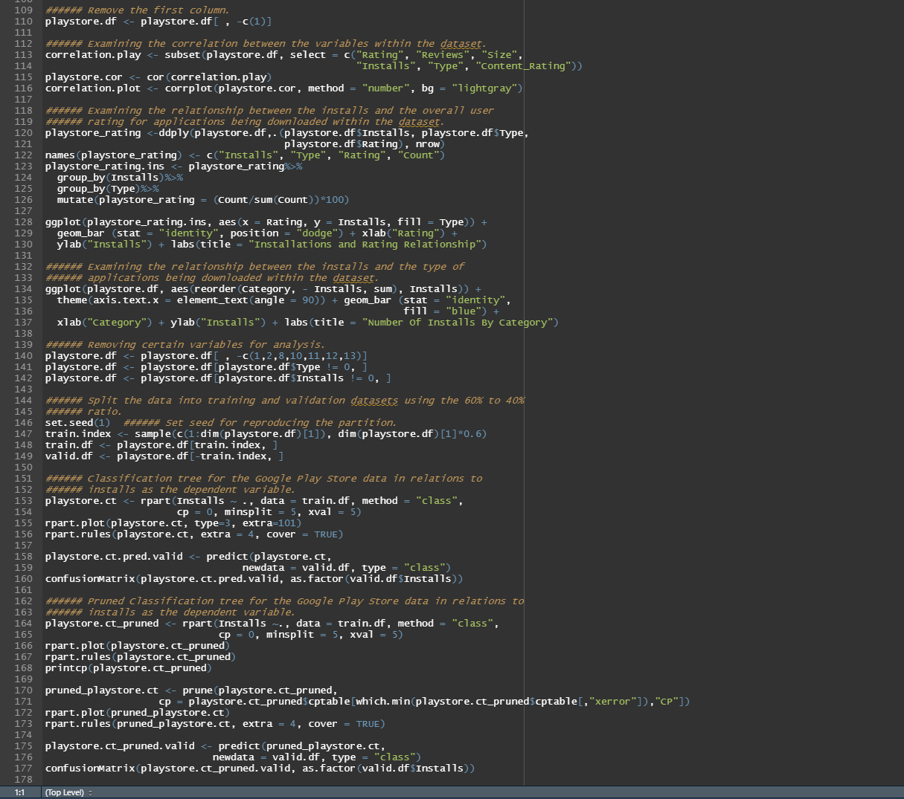

Slide 8
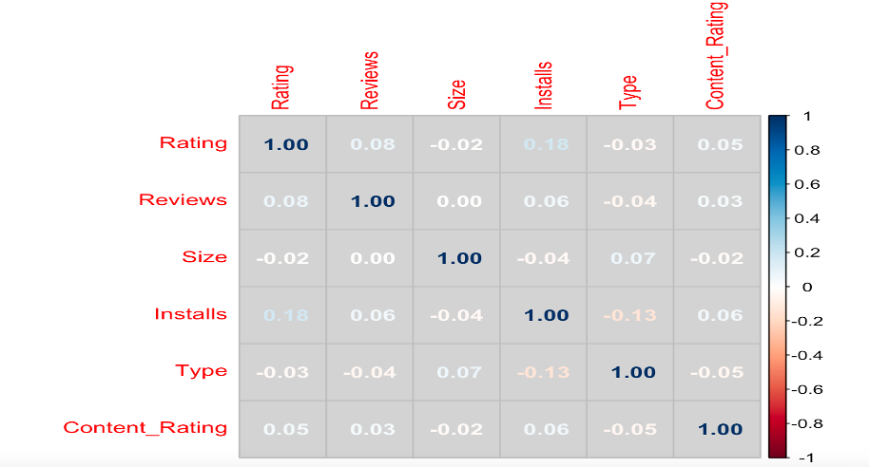
Exploratory Data Analysis
Variables that have the most correlation are installs and ratings at 18%

Slide 9
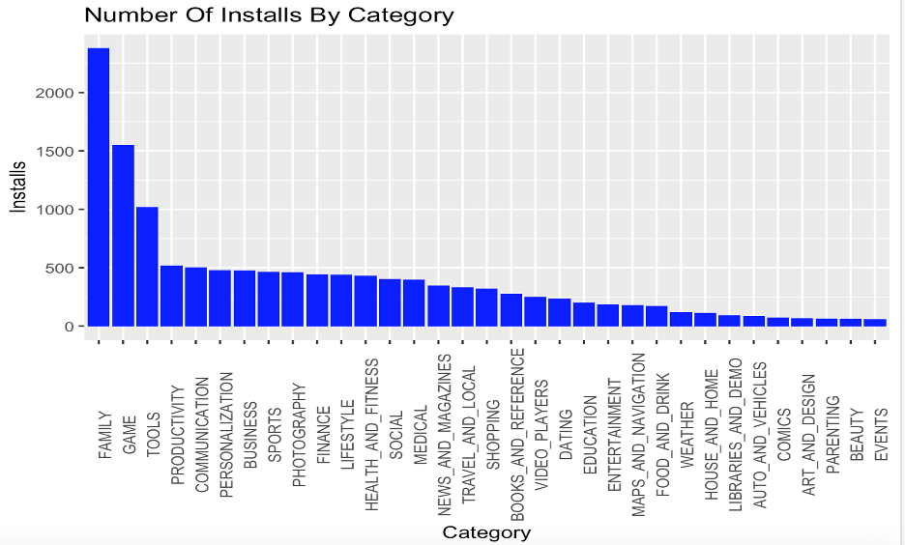
Number of Installs by app Categories

Slide 10
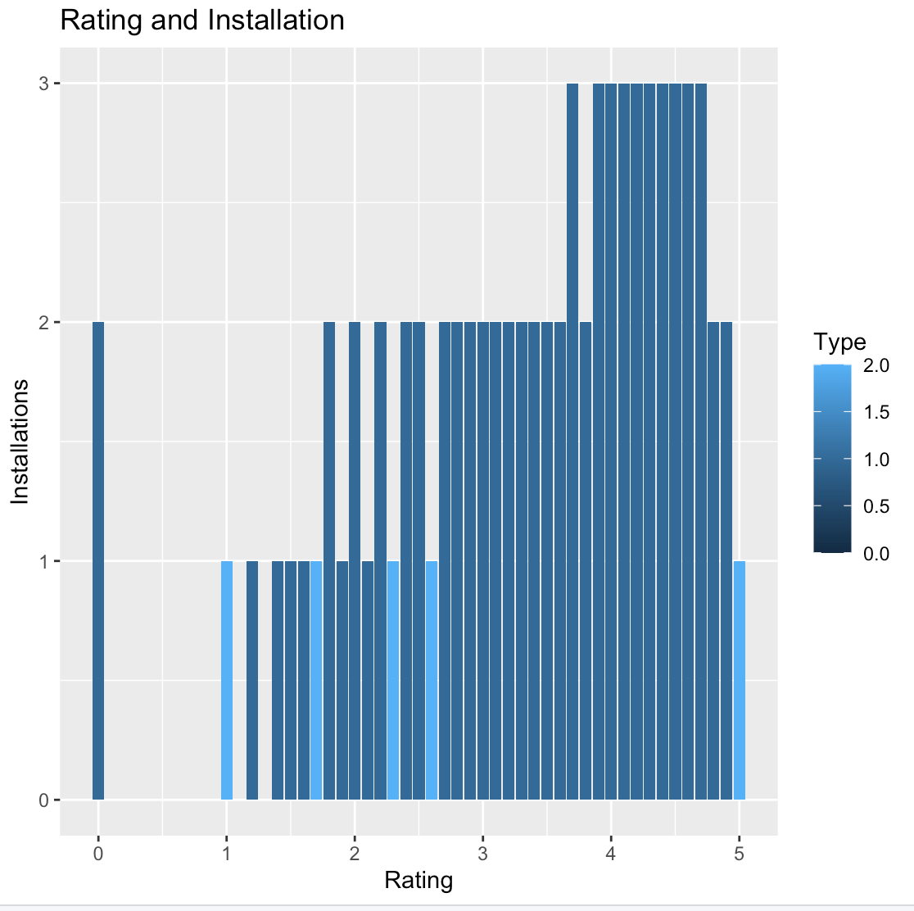
Installations with the highest rate of success have a rating between 3.6 to 4.7

Slide 11
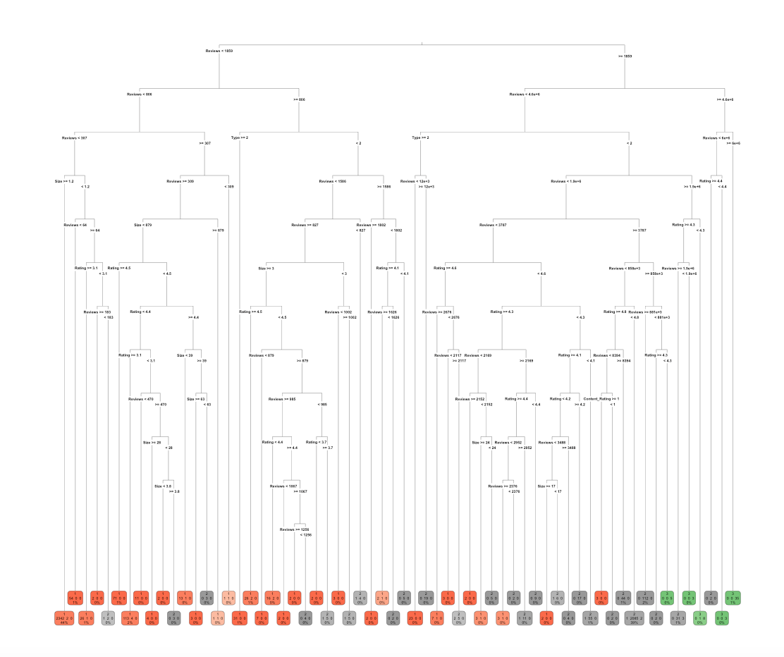
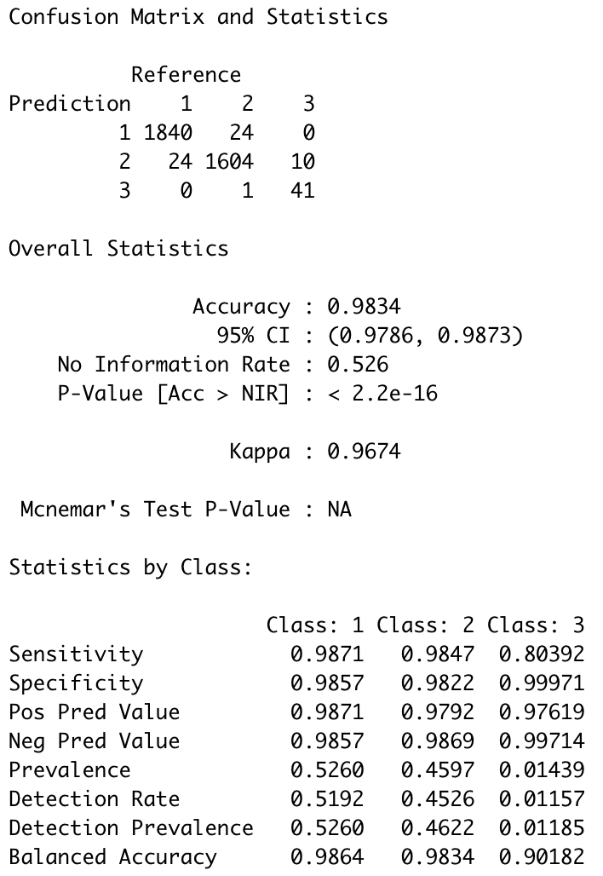
Classification Tree (Unpruned)
Text Box

Slide 12
Results
The unpruned classification tree had an accuracy of 98.34%, while the pruned tree had an accuracy of 98.56%
While both tree’s have similar accuracy, the unpruned tree was very large, making it difficult to figure out the rules, and thus, leaned more towards overfitting.
Pruning was done to counter this overfitting problem. Our pruned model has practical rules without excessive classifications.
The pruned tree shown above illustrates that the if reviews are less than 1856, 52% of the class is covered and will most likely generate low success rate of downloads

Slide 13
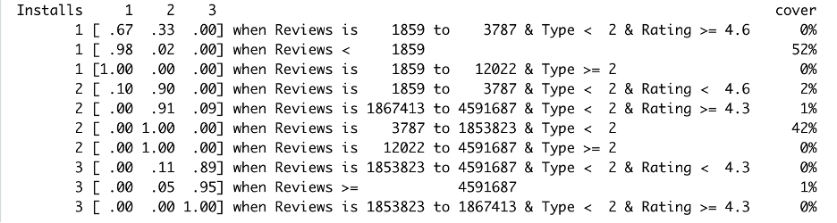
Classification Tree (Pruned): Classification Rules

Slide 14
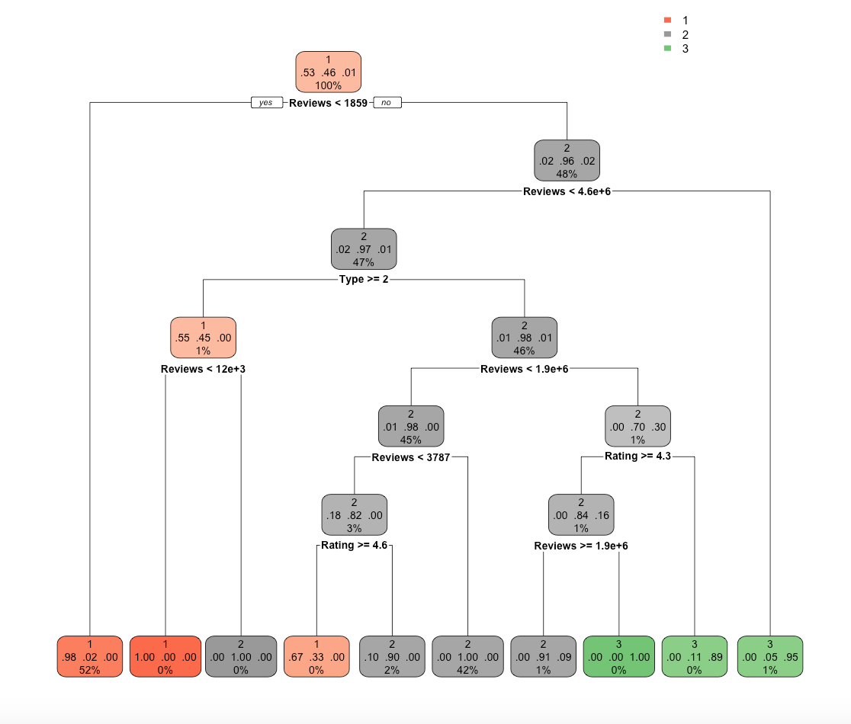
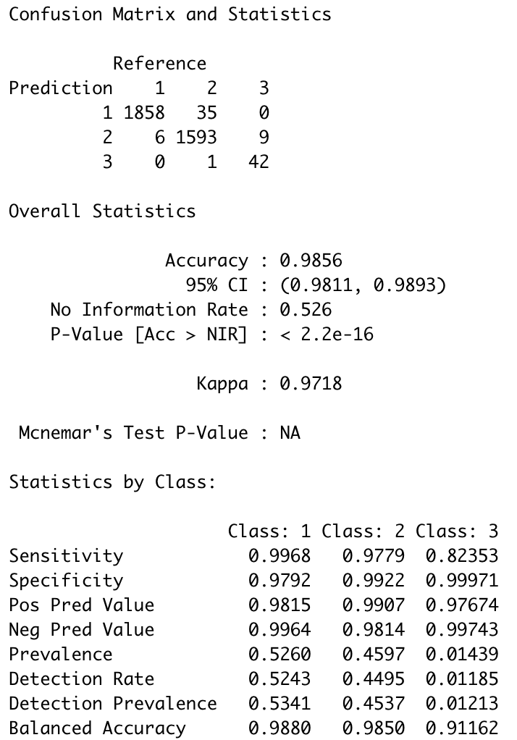
Classification Tree: (Pruned): Tree and Confusion Matrix

Slide 15

Conclusion
Reviews, ratings, and type are the variables that govern the number of downloads by consumers within the market.
Many customers tend to download mostly free applications, there is still 7% of the population that pays for applications.
The model predicted that the majority of those downloads will yield an average success, which is where Google Play Store can capitalize and exploit the market to dominate in the United States

Slide 16
Thank you

